Slide 2
Contents
01
OSCA’s 2024 goals
02
Access to the School and its facilities
03
Managing our risks
04
Marketing support for clubs
05
Sponsorship & Merit Awards

Slide 3
Andrew Wilson, OSCA President
Matt Guthridge, Committee Chair, OSCA Clubs & Societies
01 | OSCA’s 2024 goals

Slide 4
OSCA Goals
By December 2024, OSCA will have … |  | By December 2024, the C&S Committee will have …
Strengthened OSCA’s role in governance. |  | Finalised MOUs with Clubs Co-developed a ‘C&S Charter’ with the Clubs
Strengthened and broadened OSCA-related connections with the School and the wider School community. |  | Connected Year 12 boys and YOBs to OSCA’s clubs & societies Supported membership marketing for OSCA’s clubs & societies Resolved club access issues with the School
Supported more Old Boys to thrive, with a particular focus on engaging and supporting YOBs. |  | Communicated the physical and emotional well-being benefits of participating in OSCA clubs and societies Included an explicit objective to help members to thrive within the C&S Charter
Improved OSCA’s understanding of its alumni community, key segments and the unique life journeys within them, and how greater support might be provided. |  | Encouraged clubs their members to use OSCAConnect Surveyed the membership needs of OSCA’s clubs & societies
Facilitated opportunities for members of the Scotch Family to contribute to social enterprise beyond Scotch. |  | Supported the creation of an Old Scotch “Social Enterprise” club

Slide 5
Ross Congleton, Bursar, Scotch College
02 | Access to the school and its facilities

Slide 6
OSCA’s Clubs have raised concerns about School Access
The School’s Philosophy on Club Access
Does the School continue to welcome the reasonable use of school facilities by Clubs?
Has the approach to allowing access to school facilities changed?
The Booking Process
The booking process is convoluted and inefficient. Can this be improved ?
What are the guidelines used by the Events Department in deciding and making bookings?
Cleaning Charges
New ‘cleaning’ charges feel exorbitant (i.e., $400 fee for use of the Boykett Room, excluding food and drink), especially for smaller clubs
What is the policy on cleaning fees/charges and how are they calculated?
Will there by any complimentary use of function venues, to encourage ‘giving back’?
Interaction with Current Students
What is the policy in relation to the involvement of current students in clubs? There is inconsistency in the application of these standards.
What are the School’s major concerns regarding club interaction with current students?
What can the clubs demonstrate to reduce these concerns? For example, what standards must the clubs meet?

Slide 7
Stephen Webster, OSCA Vice President
Danny Tan, OSCA Clubs & Societies Committee
03 | Managing our risks

Slide 8
Two approaches to Risk Management
To ensure that every OSCA club and society appreciates, and takes reasonable steps to manage, the critical risks associated with operating within the Scotch community.
What is it?
Memorandum of Understanding (MOU)
Explicit approach to articulating the benefits OSCA provides to clubs, and the conduct OSCA requires in return.
Badminton – complete
Basketball – complete
Cardinal – complete
Collegians - complete
Cricket – complete
Film – complete
Football – complete
Athletics – in progress
Pipes and Drums – in progress
Clubs & Societies Charter
A principle-based approach to increasing awareness of key risks and issues. For example:
Adhering to all applicable school policies and procedures such as the Safeguarding Children Commitment and Anaphylaxis Policy.
Supporting the mission, purposes and reputation of the School & OSCA.
Providing a safe and welcoming environment so that all participants can enjoy Club activities.
Promoting engagement between club members and the school
Where applicable, working towards becoming incorporated associations.
Working to protect School and OSCA intellectual property
Current status

Slide 9
Caroline Taylor, OSCA Events & Communications
04 | Marketing support for clubs

Slide 10
Leveraging OSCA’s digital presence to grow
Channel | User base
Facebook | 1,705 followers
Instagram | OSCA – 476 followers YOBS – 990 followers
LinkedIn | 1,265 followers
Great Scot magazine | 23,000
OSCAconnect | Over 2000 registered users

Slide 11
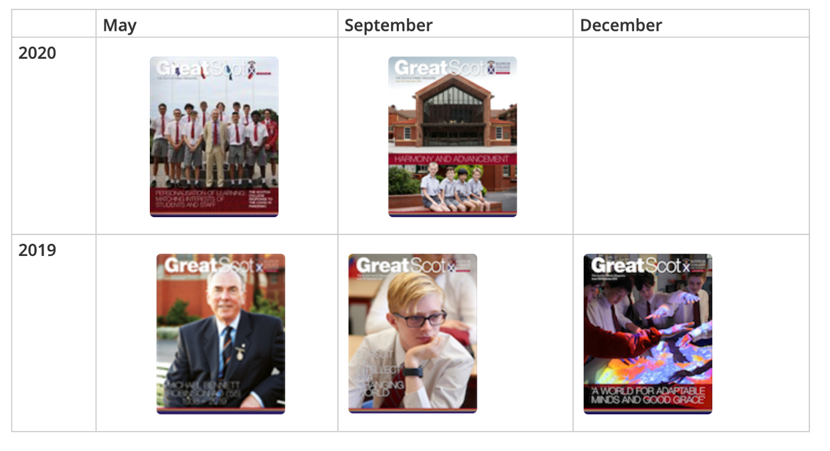
Great Scot Magazine
Published 3 times a year this magazine is for the Scotch Community
Provides clubs the opportunity to submit articles on news and events.
Available online in digital format.

Slide 12
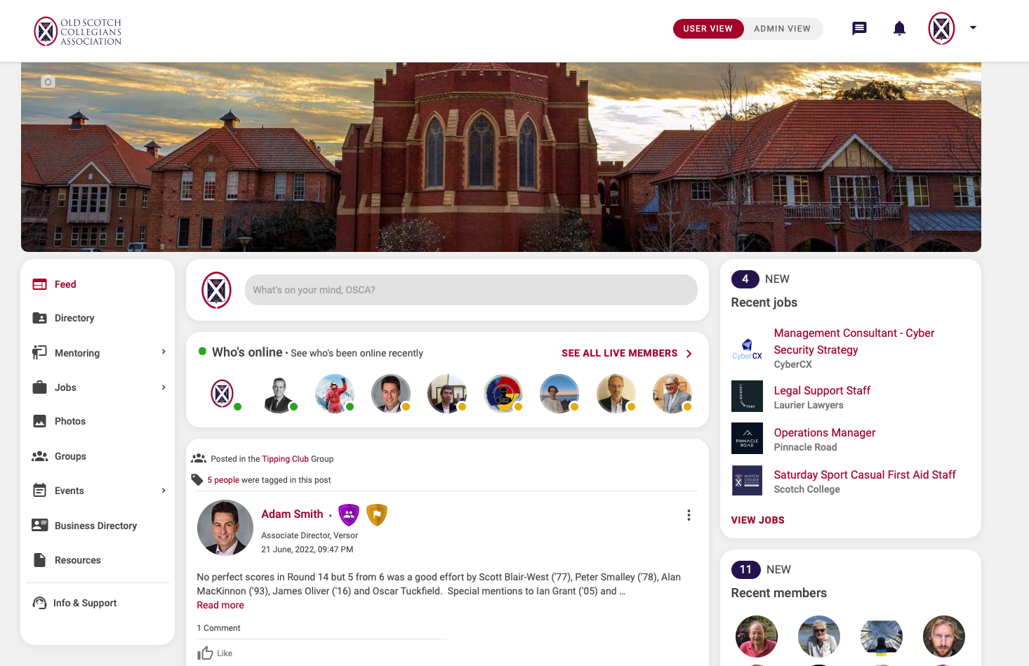
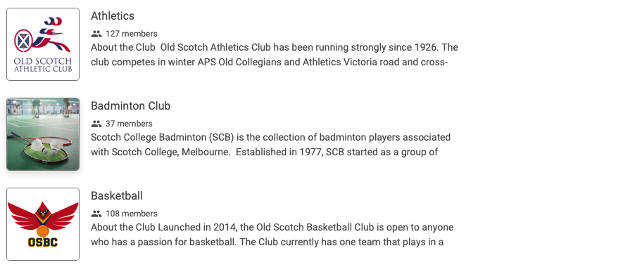
OSCAConnect www.oscaconnect.com.au
Alumni Portal- Registrations required with over 2000 registered members
Each club has a group with their own feed for news, events and photos
Resource folders available to store media
Group members– anyone who has selected your club as an ‘interest’ on registration
Through OSCAconnect, clubs and societies can:
Communicate what they do to active alumni and promote the benefits of club membership
Set-up and post events and send event invites to group members and download RSVP lists
Message group members
Post news and update to their group feed
Upload event photos (any group member can do this and post the group feed)

Slide 13
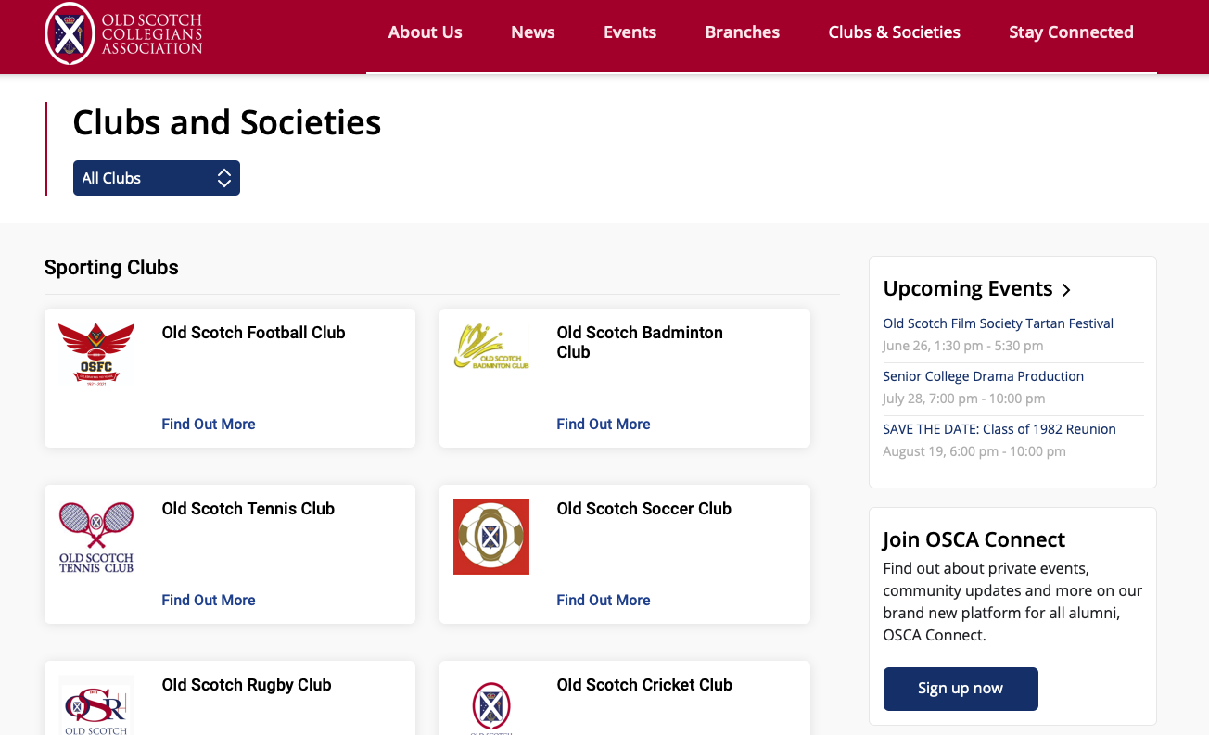
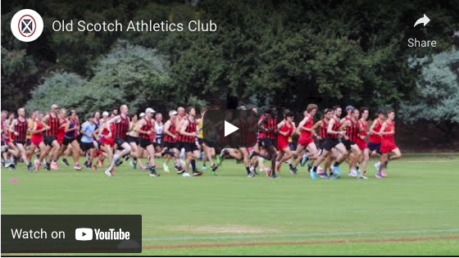
OSCAnet www.oscanet.com.au
Each club has its own page:
Downloadable forms, linked to website, description, photos
Club videos – produced by YOBs now for 6 clubs & societies.

Slide 14
Philip Wright (‘69), Acting OSCA Executive Director
05 | Sponsorship and Merit Awards

Slide 15
Sponsorship – investing in the future of clubs
OSCA Sponsorship Criteria
Single or multi-year proposals
Focused on strategic investments to
Support membership growth
Build core capabilities
Enhance club resilience, including digital capabilities.
Not for covering operational running costs
Potential for 50/50 investments.

Slide 16
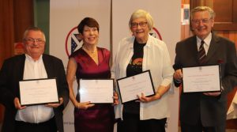
Merit Awards – recognising contributions to clubs
Bestowed on those whose commitment to an OSCA club or society has been, in the view of its members, of an outstanding nature
Factors include:
10+ years of involvement within the OSCA environment
Holding leadership positions in affiliated clubs and societies over a substantial period.
Long-term membership (20 years or more) and outstanding participation in affiliated clubs and societies
Strong support of the nomination by members of the club or society.
Unique contribution of the member that should stand as the most important criterion
Merit Awards are available each year.

